Slide 1
Adding Images to PowerPoint
There are several options for adding images to your PowerPoint presentations. You can add electronic images from many sources such as scanned images, images downloaded from the Internet and images stored on your computer. You can also find and save sounds and videos from the web which can be inserted to enhance PowerPoint presentations.

Slide 2
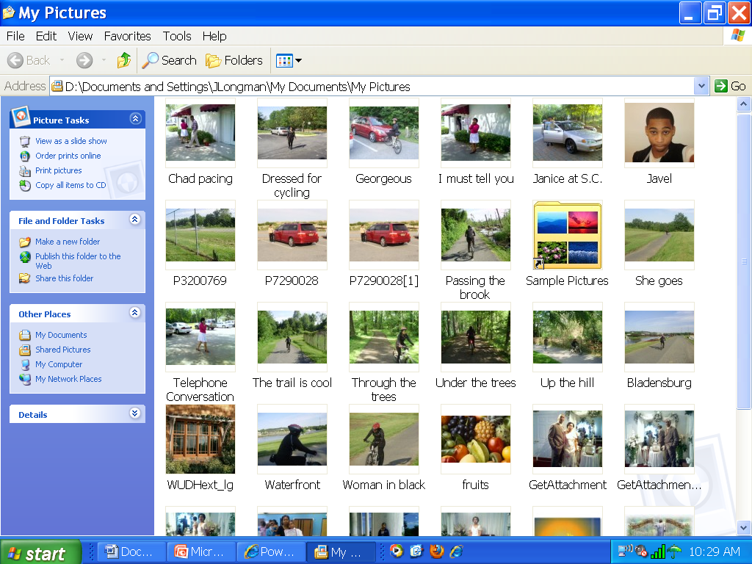
Saving images
Make sure you save your images in a folder such as pictures folder

Slide 3
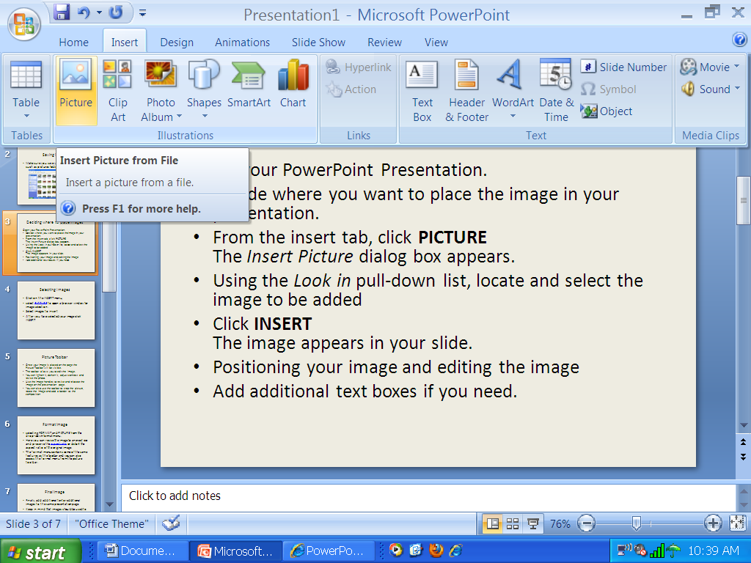
Inserting images
From the Insert tab, select PICTURE to open a browser window for image selection.
Using the Look in pull-down list, locate and select the image to be added
Click insert and the image appears in your slide.

Slide 4
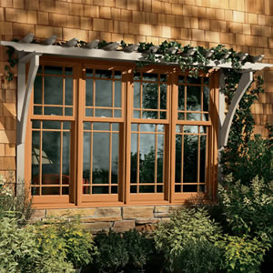
Image inserted
After you have
selected your
image click INSERT

Slide 5
Image on Slide
Once your image is placed on the page the Picture Toolbar will be visible.
The toolbar allows you to edit the image.
You can lighten it, darken it, adjust contrast and resize the photo.
Use the image handles to resize and relocate the image on the presentation page.
You can also use the toolbar to crop the picture, rotate the image and add a border to the composition

Slide 6
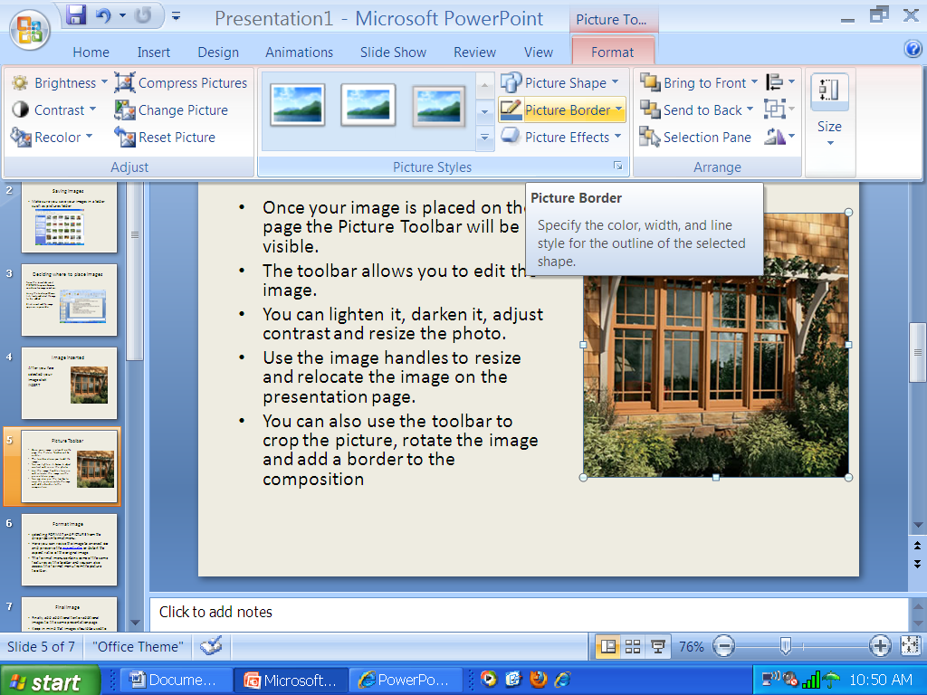
Picture Toolbar

Slide 7
Format image
Selecting FORMAT and PICTURE from the drop-down format menu.
Here you can resize the image to an exact size and preserve the aspect ratio or distort the aspect ratio of the original image.
The format menu contains some of the same features as the toolbar and you can also access the format menu from the picture toolbar.

Slide 8
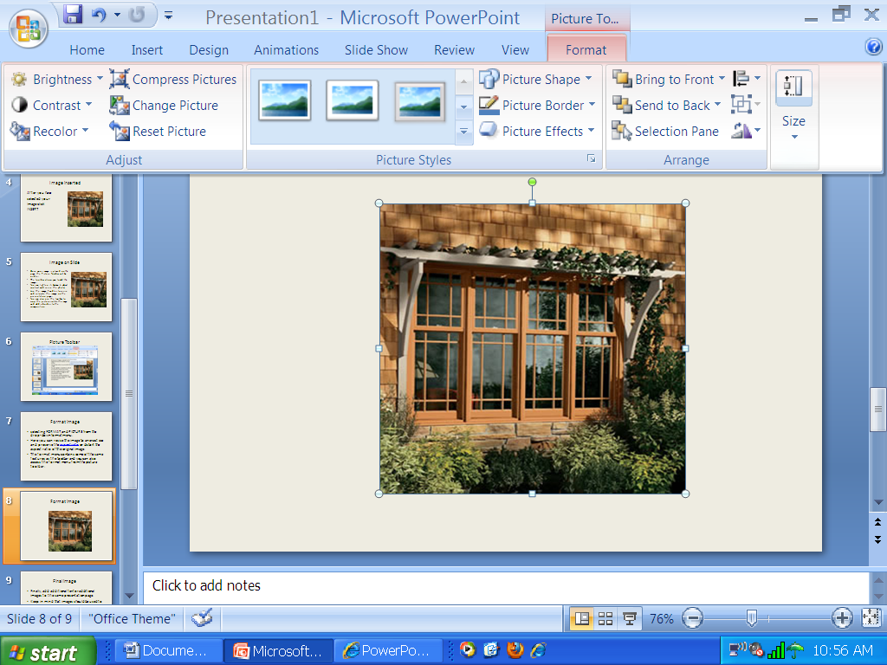
Format image

Slide 9
Final image
Finally, add additional text or additional images to the same presentation page.
Keep in mind that images should be used not only to enhance your presentation but to provide instruction for learners.

Slide 10
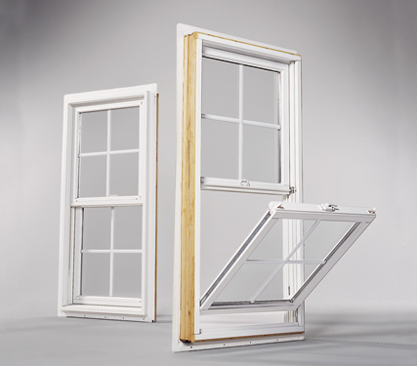
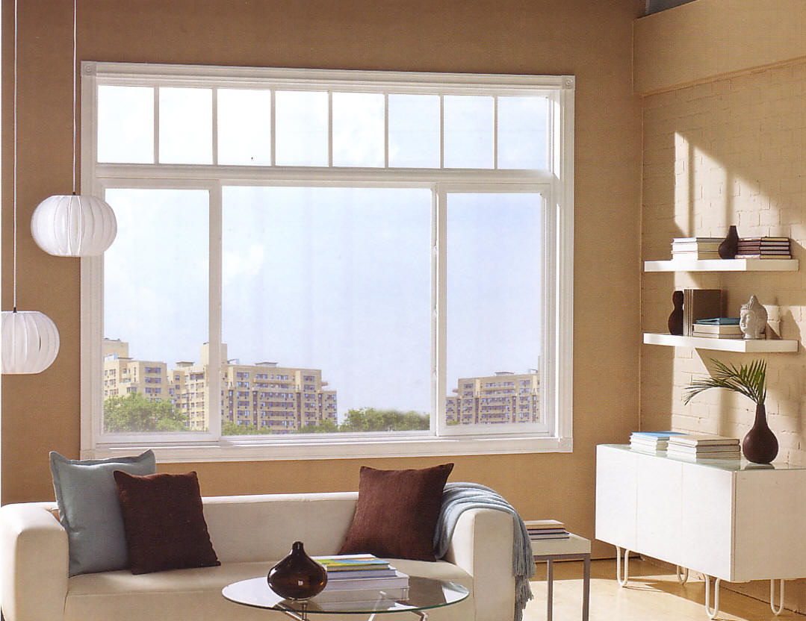
Additional images and text
.
Double Hung– One of the most common windows and a great window for a period home. The window consists of two sashes that move up and down. Only half of the window can be open at one time
Fixed– This type of window cannot be opened. It is usually inexpensive and suitable for higher windows that won’t be opened anyway

